Slide 1
Job Portal with Resume Parsing and Matching
COURSE:-DATABASE SYSTEMS ENGINEERING AND DISTRIBUTED BACKEND DEVELOPMENT
•COURSE CODE: 25CS1302E
TEAM 12
K. Aasritha Sai Lakshmi — 2520090006
Komali Varnika — 2520090010
Divya Sree — 2520090031
REVIEW 3

Slide 2
Abstract
•Recruitment can be time-consuming because recruiters have to manually check many resumes.
•The project Job Portal with Resume Parsing & Matching makes the recruitment process faster and easier.
•Candidates can upload their resumes, and the system automatically extracts skills, education, and experience.
•The system compares the candidate's skills with the job requirements.
•It provides a matching score to help recruiters find suitable candidates.
•MongoDB stores activity and log information.
.Overall, the project provides a faster, smarter, and more efficient way to find suitable candidates.
2

Slide 3
Problem Statement
Recruiters face significant challenges in hiring: they must manually screen large volumes of resumes, which consumes time and effort, often makes it difficult to identify the right candidates, and can lead to inaccurate skill matching. As applications increase, managing the entire hiring process becomes even more complex.
Objectives
  Automate resume parsing to extract candidate details and skills
  Enable accurate skill‑to‑job requirement comparison
  Provide a candidate suitability/matching score for quick shortlisting
  Simplify and accelerate the overall recruitment process
3

Slide 4
Proposed Solution
1.Candidate uploads resume
2.Resume parsing extracts text & data
3.Skills and qualifications identified using NLP
4.Job requirements compared with candidate profile
5.Matching score generated for suitability
6.Recruiter shortlists candidates based on score
3

Slide 5
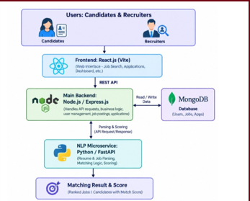
System Architecture
3

Slide 6
FRONTEND OVERVIEW
  Core Stack: Developed using React 19 and Vite for high performance and fast, reactive page loads.
  Role-Based Portals: Dedicated, isolated dashboards for Candidates (apply, track, upload) and Recruiters (post jobs, review applicants).
  Resume Upload & Parsing: Drag-and-drop interface supporting PDF and DOCX files with instant upload status.
  Visual Match Analytics: Displays real-time match percentages, matching skills, missing skill gaps, and experience breakdowns.
  Clean UI Design: Styled with responsive CSS and Lucide React icons for an intuitive, modern user experience.
3

Slide 7
BACKEND OVERVIEW
  Dual-Service Architecture: Powered by a Node.js / Express REST API coordinating with a specialized Python FastAPI microservice.
  Secure Authentication: Implements JWT (JSON Web Tokens) and bcryptjs password hashing with strict role-based access control.
  Database & Persistence: Uses MongoDB with Mongoose ODM to store user profiles, job listings, parsed resume entities, and applications.
  NLP & Explainable Matching: Combines spaCy skill extraction with weighted scoring: $$\text{Match Score} = 60%\text{ Skills} + 25%\text{ Experience} + 15%\text{ Education}$$
3

Slide 8
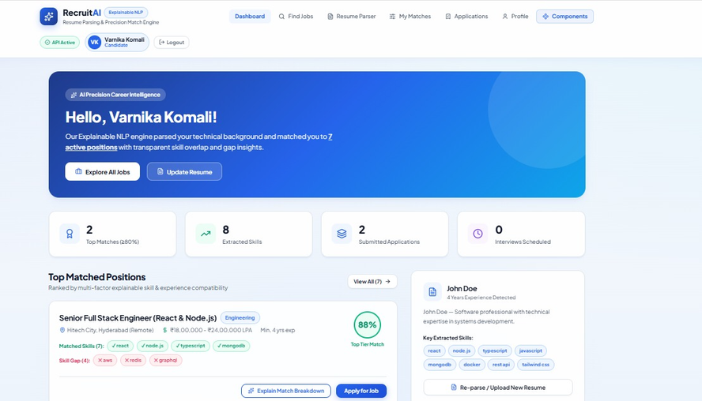
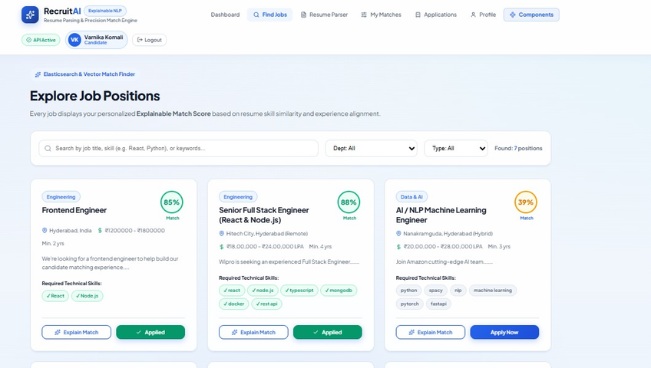
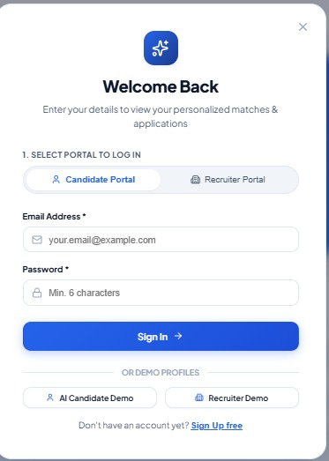
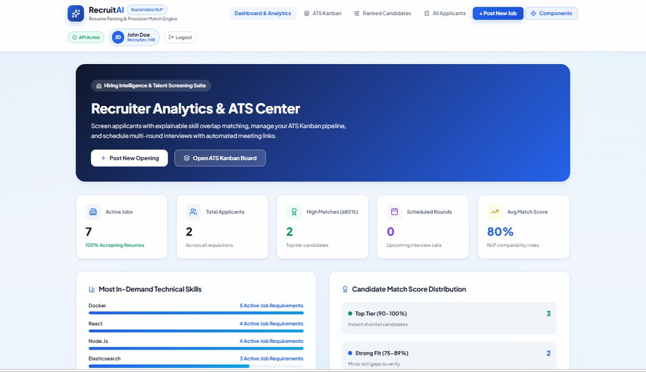
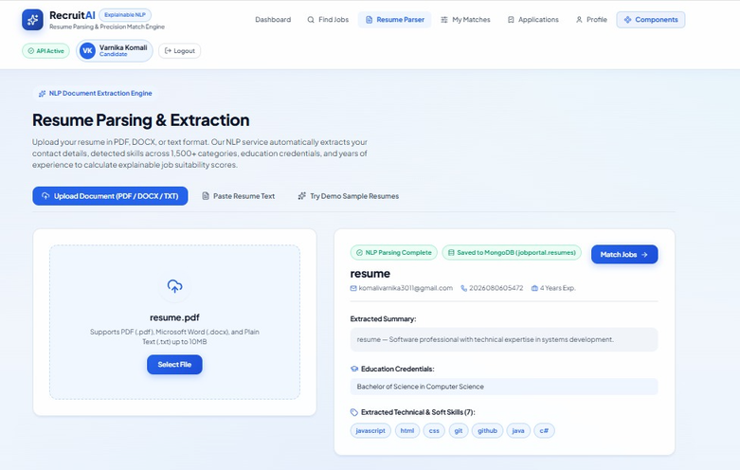
WEBSITE OUTPUT
3

Slide 9
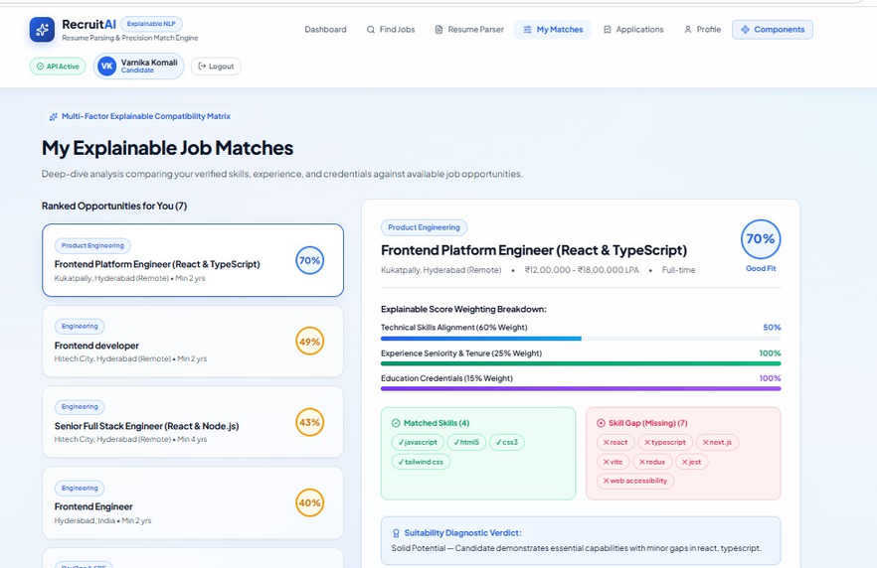
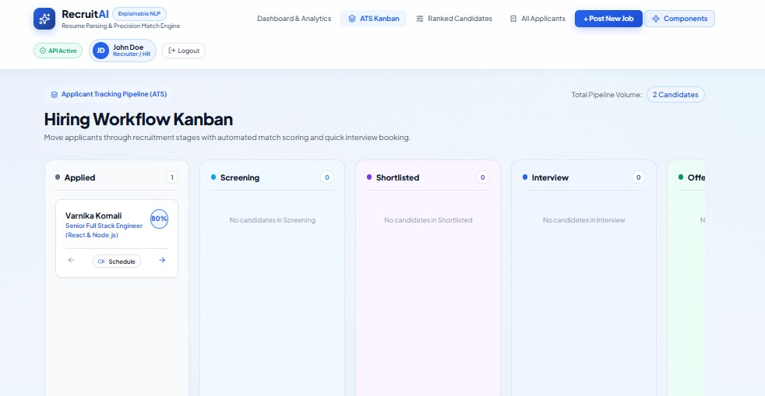
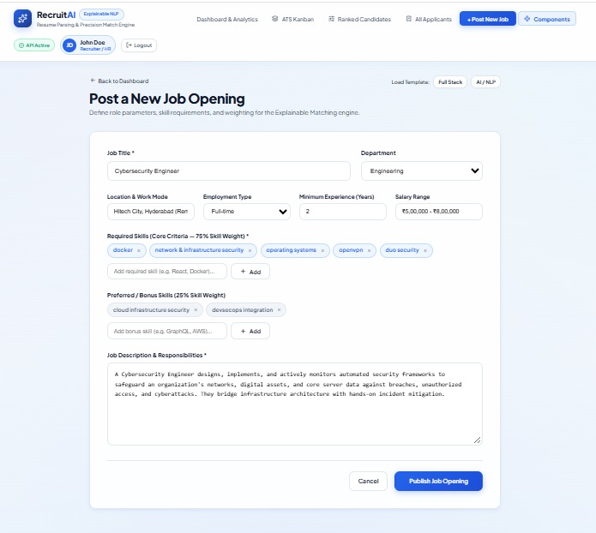
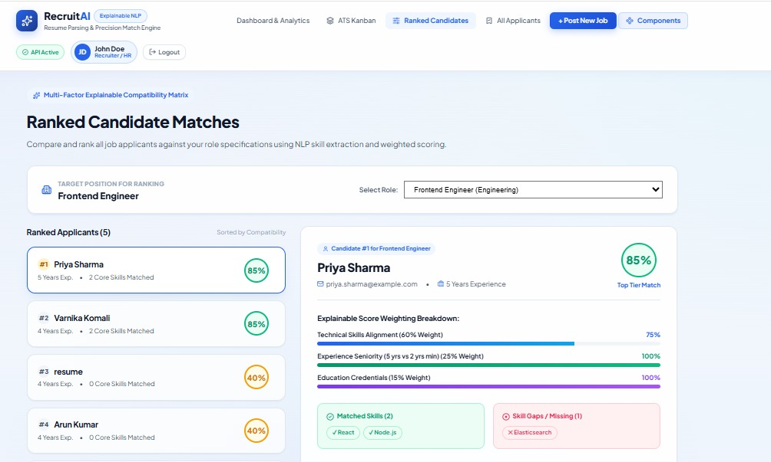
3

Slide 10
Thank you

